Slide 1
Automatic Alignment of Long Syllables in
A Cappella Beijing Opera
Georgi Dzhambazov, Yile Yang, Rafael Caro, Xavier Serra
CompMusic Project – Universitat Pompeu Fabra
georgi.dzhambazov@upf.edu
6th International Workshop on Folk Music Analysis
Dublin Institute of Technology
17 June 2016

Slide 2
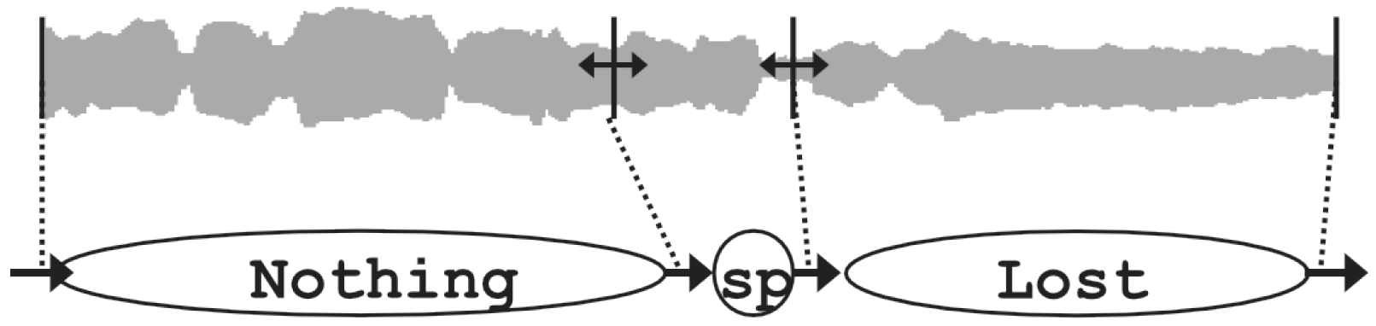
Introduction
What is lyrics-to-audio alignment? automatic matching between an audio recording and its lyrics: phrases/words/syllables
State-of-the-art approaches:
(Fujihara, 2012):
Most work is on pop music with speech-adopted approach
methodology | training | evaluation dataset
phoneme recognizer | speech | English pop, Japanese pop, Cantonese pop
Notes:
Deezer and spotofy

Slide 3
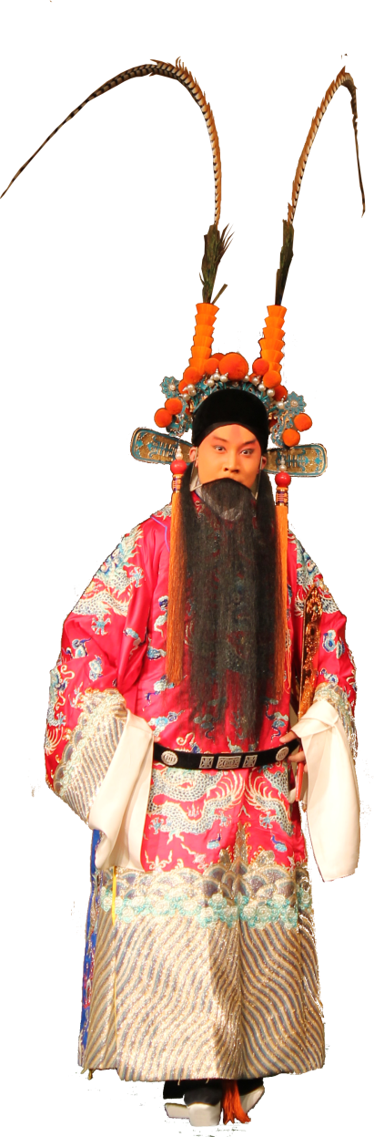
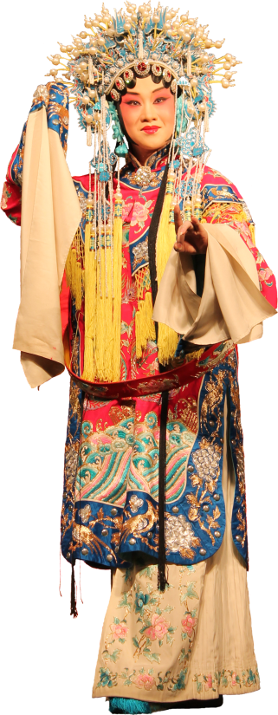
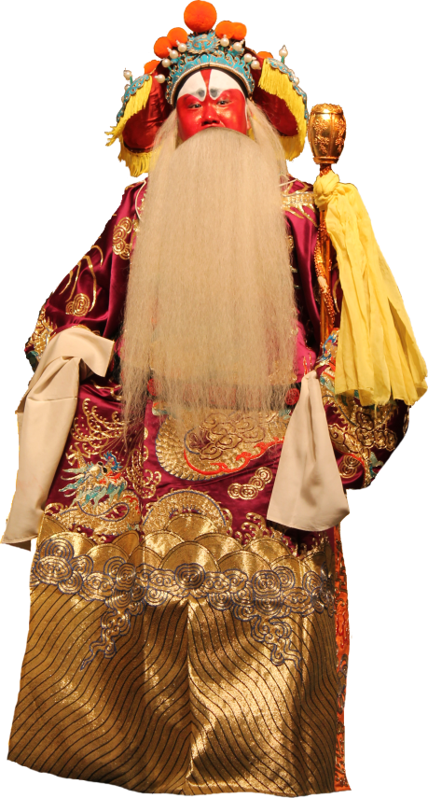
What is Beijing opera (a.k.a. Jingju)
Unique singing style
Language: Mandarin + dialects
Different metrical patterns (banshi):
manban (slow)
kuaiban (fast)
Different role types
dan
laosheng
jing
Notes:
Banshis change within a song: usually from slow to fast.

Slide 4
Example excerpt from an aria
Average duration: 3.1 sec
Max duration: 8 sec
Notes:
Tenney and Polansky 1980
Cambouropoulos, 2001, 2006
Information Dynamics Of Music or IDyOM Pearce 2005, based on multiple viewpoints Conklin 1995

Slide 5
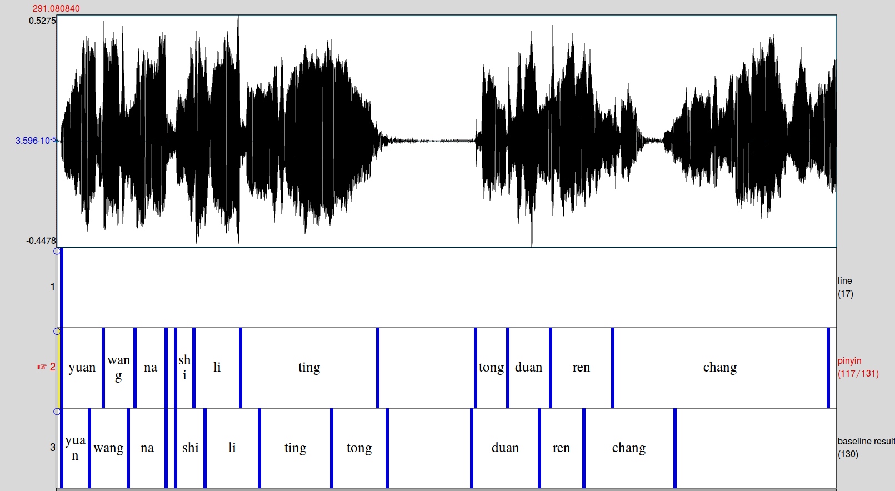
Example excerpt from an aria:
performance of baseline with phonetic recognizer
Premature transition to next syllable for long syllables
Notes:
Tenney and Polansky 1980
Cambouropoulos, 2001, 2006
Information Dynamics Of Music or IDyOM Pearce 2005, based on multiple viewpoints Conklin 1995

Slide 6
Motivation
Why alignment?
To facilitate navigation
For musicological studies
For singing students and teachers
Why model durations?
Application of state-of-the-art phonetic recognizer:
not satisfactory results
unaware of music-specific knowledge
Notes:
Students to compare singing of two masters of same aria

Slide 7
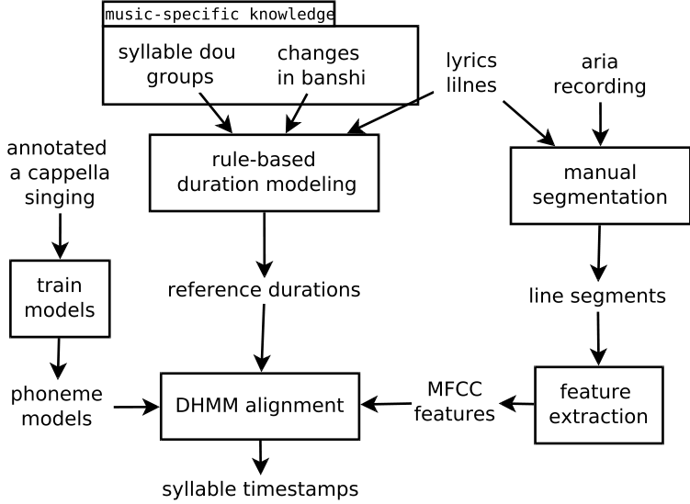
Approach Overview

Slide 8
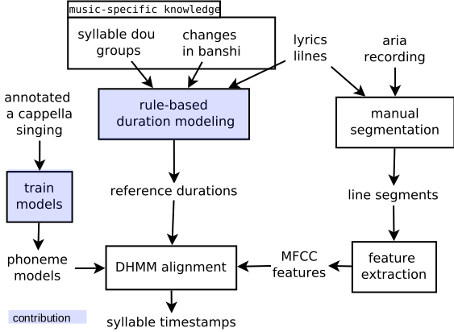
Approach Overview

Slide 9
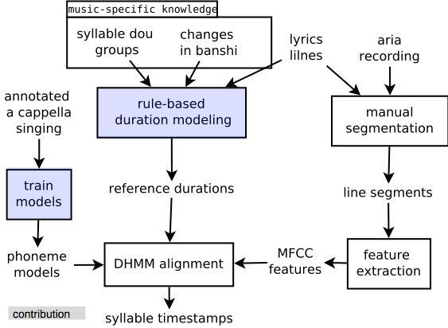
Approach Overview

Slide 10
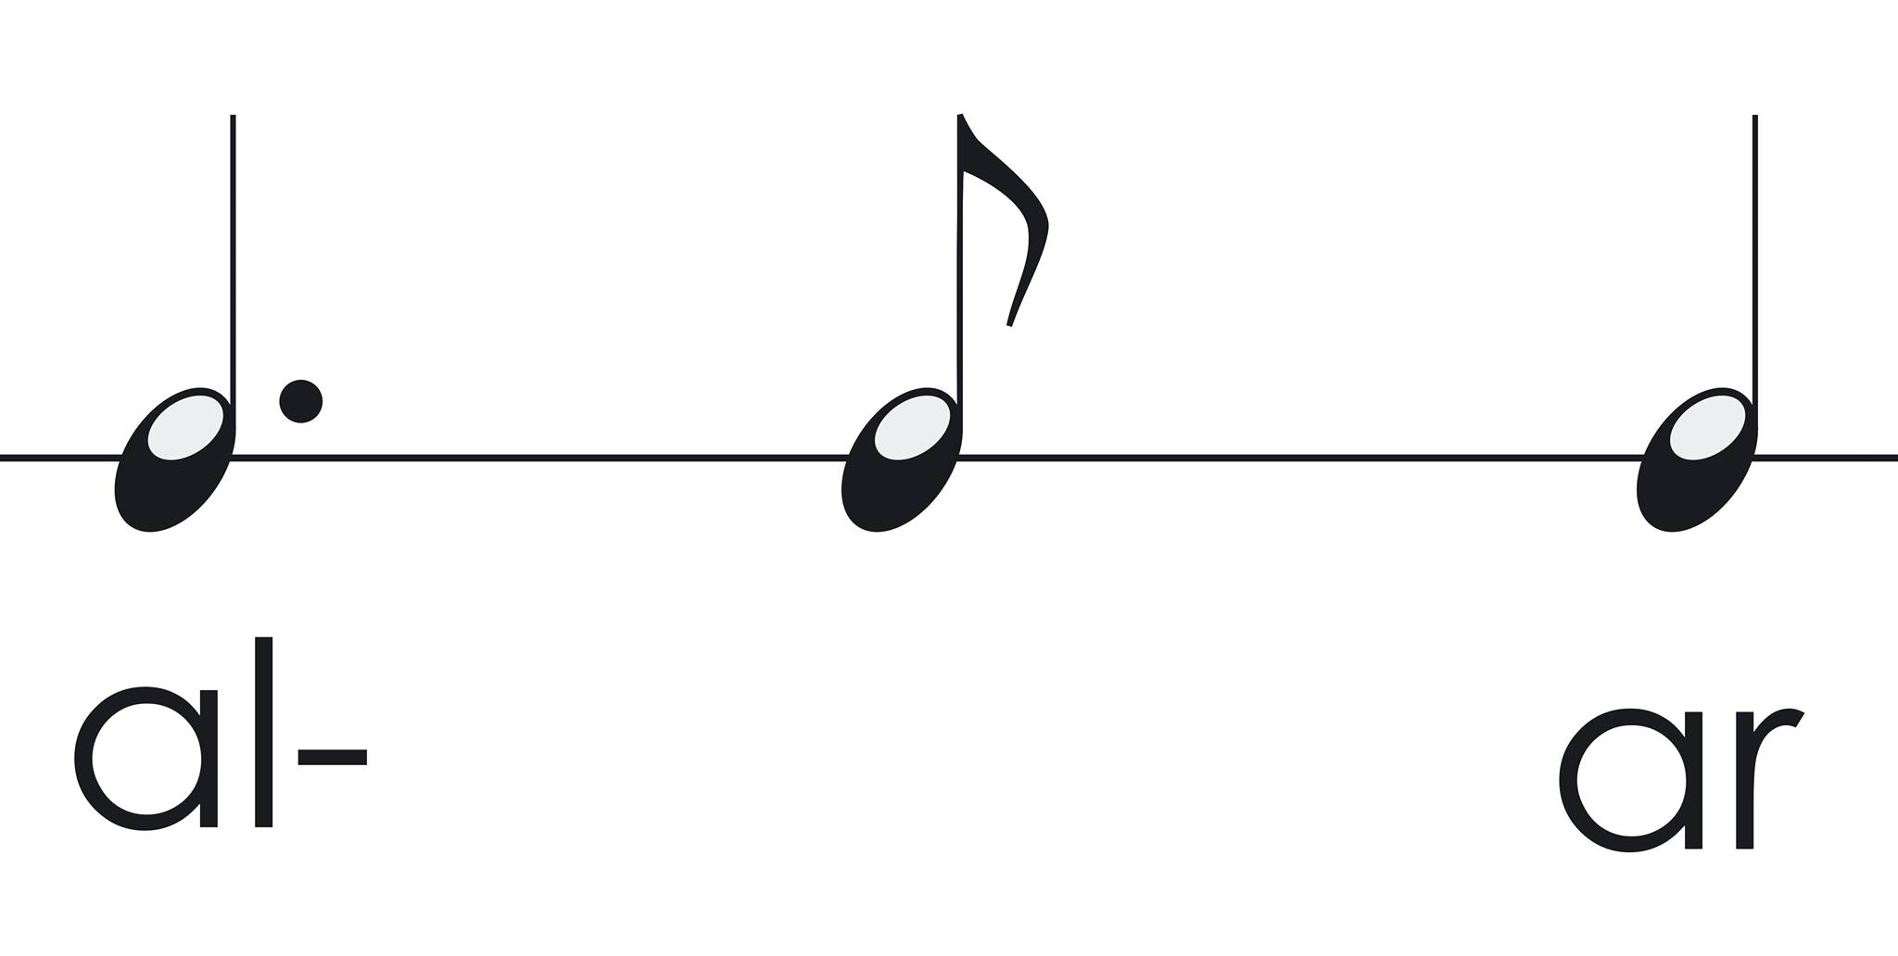
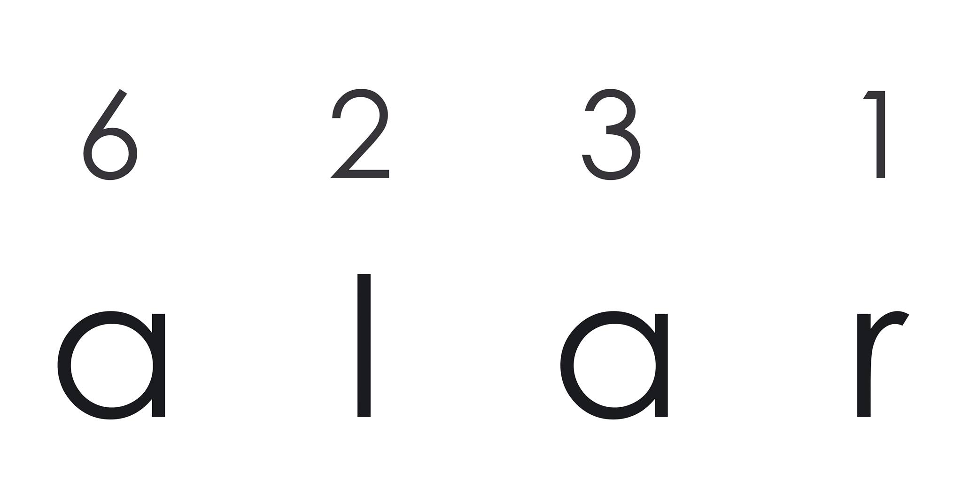
Syllable reference durations: model from score?
(Dzhambazov et al. 2015)
Restriction: need of score

Slide 11
Syllable reference durations: model from training data?
(Kruspe et al. 2015)
Restriction: looses context: position of a syllable in a line (same duration)

Slide 12

Jingju-specific principles
Lyrics from poetry: divided into lines
Each line has 2 or 3 dou
玉堂春含悲泪忙往前进，
想起了当年事好不伤情！
每日里在院中缠头似锦，
到如今只落得罪衣罪裙。

Slide 13
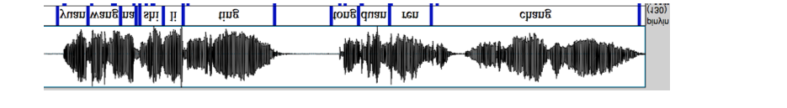
Syllable duration rules
Assign syllables ratios from total line duration
Split into phoneme reference durations R_i
1/5
1/4
1/3
Notes:
Stretch to fit a line
Split into phonemes according to simple rules

Slide 14
Approach Overview

Slide 15
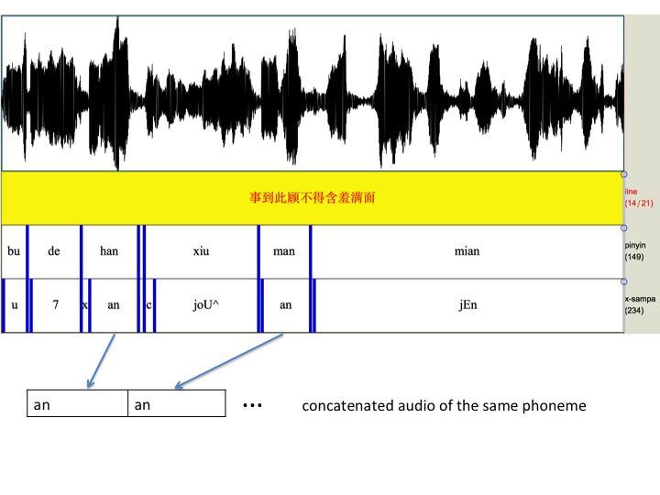
Phoneme models
Phoneme models
29 phonemes + silence: GMM with MFCCs
Trained on annotated singing voice

Slide 16
Approach Overview

Slide 17
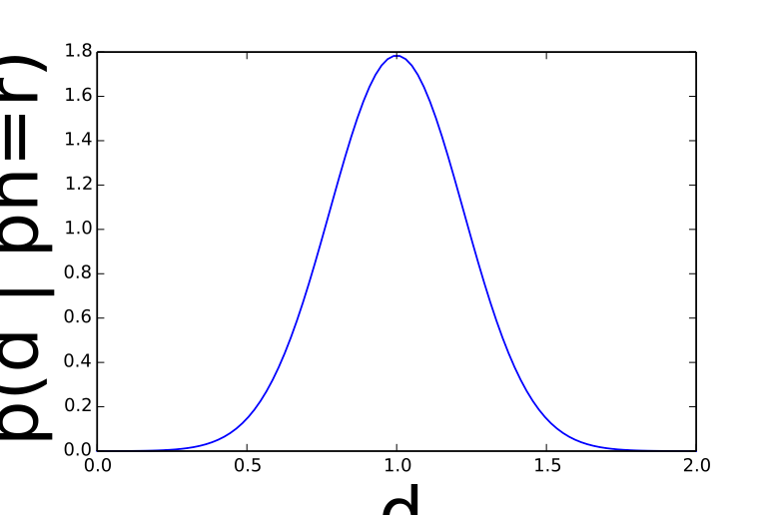
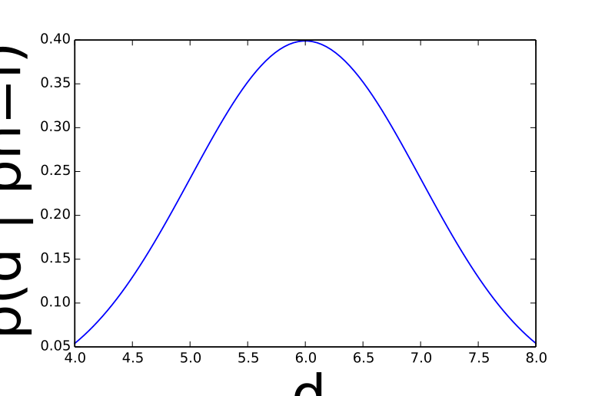
Duration-explicit hidden Markov model
….

Slide 18
Duration-explicit hidden Markov model

Slide 19
Dataset stats

Slide 20
Dataset stats

Slide 21
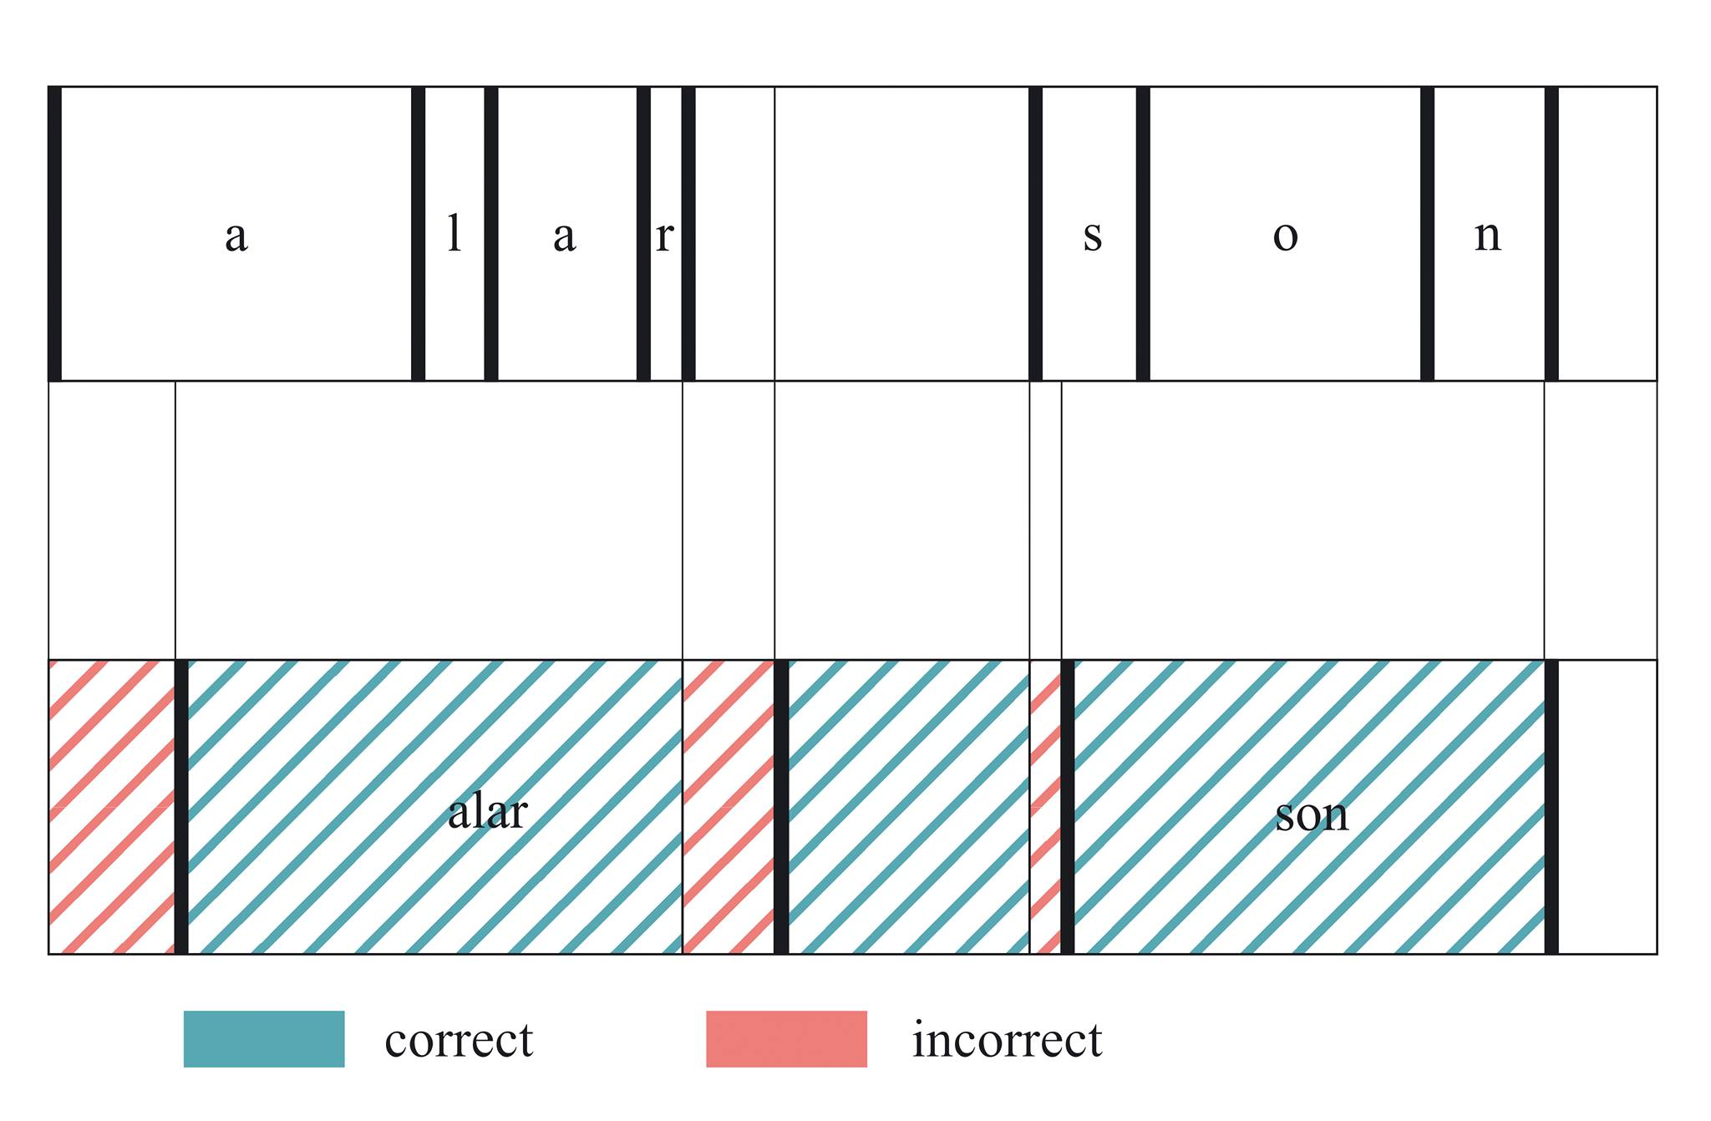
Evaluation

Slide 22
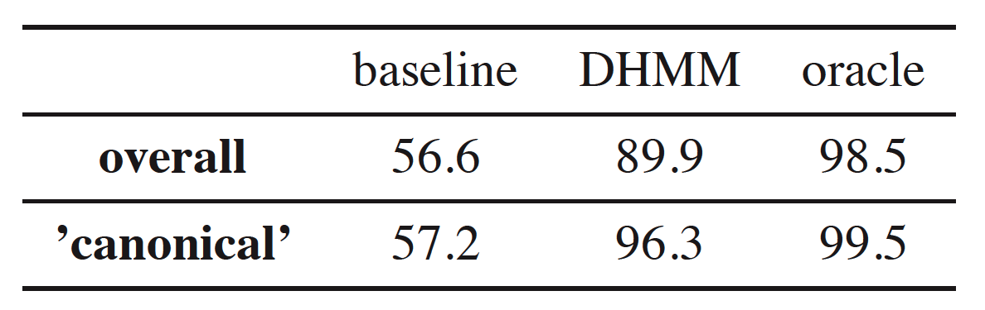
Results

Slide 23
Demo

